Slide 1
MY Kost
M Hudya Ramadhana
Mutia Ayu Dianita
4 sc 1

Slide 2
background

Slide 3
System Summary

Slide 4
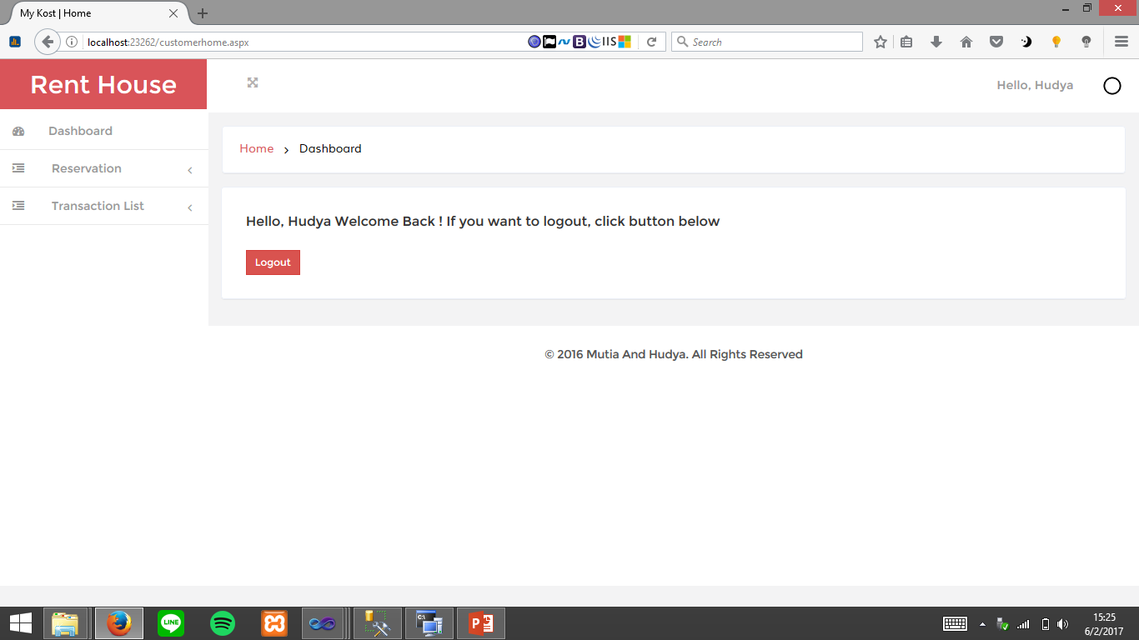

Slide 5
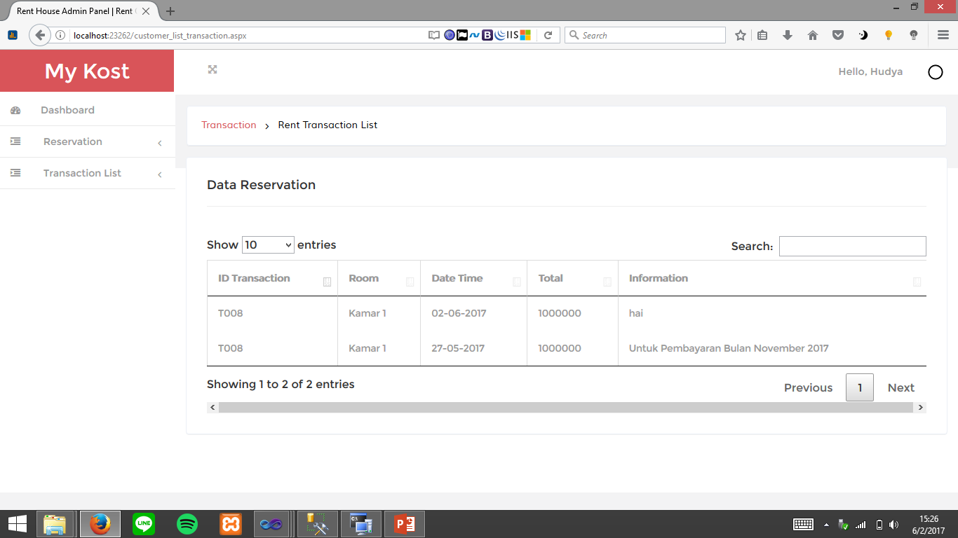

Slide 6
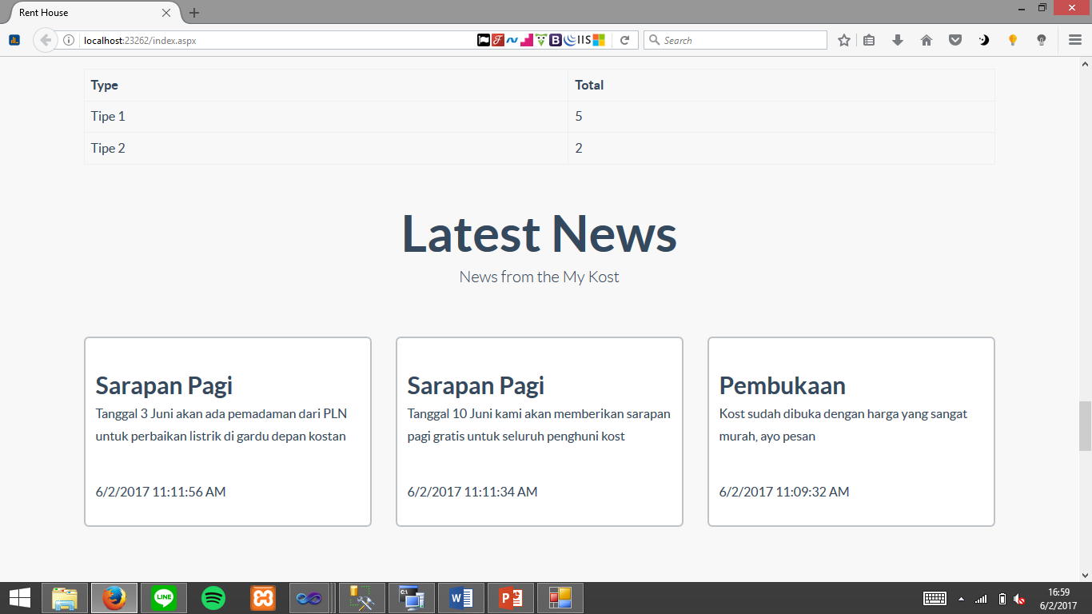

Slide 7
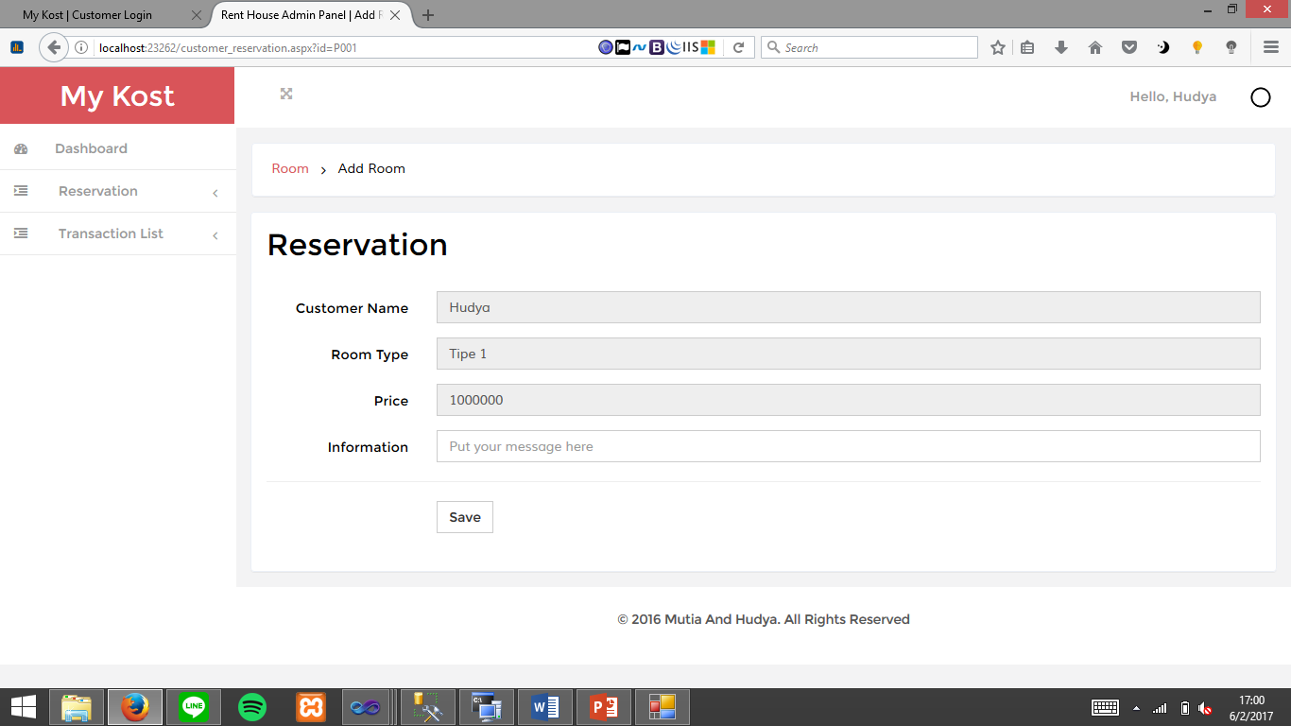

Slide 8
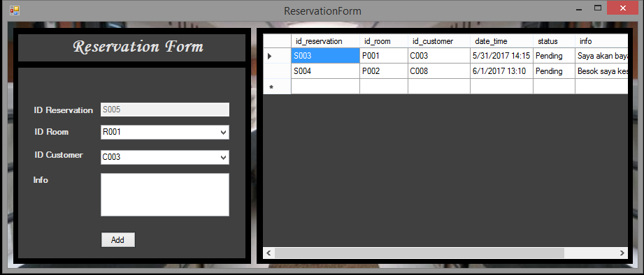

Slide 9
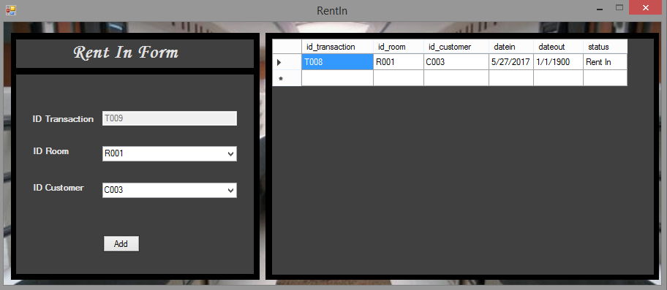

Slide 10
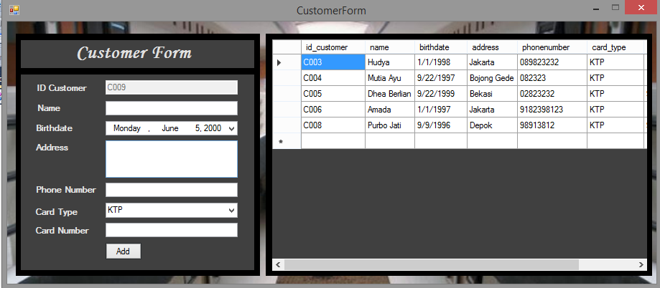

Slide 11
